Slide 1
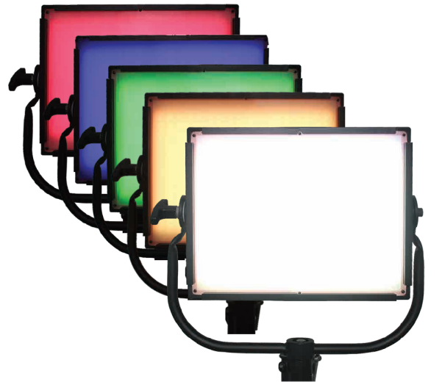
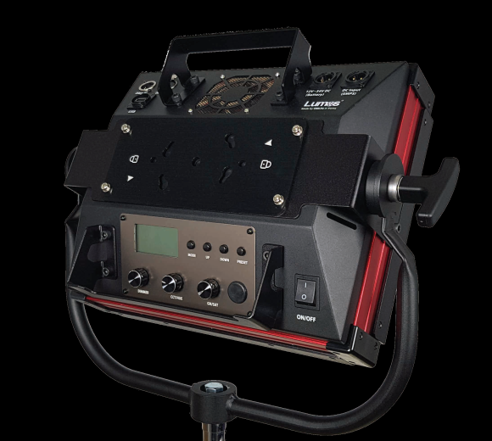
200C
Ideal for the Location, Commercial
and Entertainment
1K Tungsten Output
Full Color RGBW LED
2,800K~10,000K
All metal Body
Hybrid cooling system
Flicker free
Stable dimming (0~100%)
Standard DMX 512 / RDM
Useful 10 Presets
Easy operation
Photometric information of Lumos Glow panel 200C
CCT | 4 ft | 8 ft | 12 ft | 16 ft | 20 ft | 1m | 2m | 3m | 4m | 5m
3200K | 430.5 Fc | 107.6 Fc | 47.8 Fc | 26.9 Fc | 17.2 Fc | 6,888 lux | 1,722 lux | 765 lux | 431 lux | 275 lux
5600K | 435.8 Fc | 108.9 Fc | 48.4 Fc | 27.2 Fc | 17.4 Fc | 6,973 lux | 1,743 lux | 775 lux | 436 lux | 279 lux
Lumos Glow panel 200C Specifications
Power Consumption | 200W Nominal / 230W Maximum
Size | W477.3 * H509.2 * L148.6 (mm) / W18.8 * H20.0 * L5.9 (inch)
Weight | 10.6 kg / 23.4 lb
Color Temperature | 2,800K~10,000K / Green-Magenta Adjustable
Colored Light | Full RGB, White color / Hue and Saturation Control
Input Voltage | 20~36V DC (SMPS, Battery)
Dimming | 0~100% Manual
Control | DMX512 / RDM
Software update | USB
Flicker | Flicker free
Cooling system | Hybrid cooling system (fan)
Operating Temp. | 0℃ ~ 45℃
Accessory | SMPS bracket 4-leaf barndoor Pole operated yoke Diffusing filter Ball-mount bracket Snap bag Snap grid
Color temperature | 3200K | 5600K
CCT Tolerance | ±150K | ±150K
CRI | 96 Ra | 95 Ra

Slide 2
Photometric information of Lumos Glow panel Series
Model | Beam angle |  |  | 1m | 2m | 3m | 4m | 5m
Lumos Glow panel 400C 400W | 85˚ | Illumination | 3200K | 12,587 lux | 3,147 lux | 1,399 lux | 789 lux | 504 lux
 |  |  | 5600K | 12,466 lux | 3,117 lux | 1,385 lux | 779 lux | 501 lux
 |  | Beam diameter | Width | 2.4 m | 4.3 m | 6.0 m | 7.9 m | 9.8 m
 |  |  | Height | 2.1 m | 4.0 m | 5.8 m | 7.6 m | 9.4 m
Lumos Glow panel 200C 200W | 85˚ | Illumination | 3200K | 6,888 lux | 1,722 lux | 765 lux | 431 lux | 275 lux
 |  |  | 5600K | 6,973 lux | 1,743 lux | 775 lux | 436 lux | 279 lux
 |  | Beam diameter | Width | 2.2 m | 4.0 m | 5.8 m | 7.7 m | 9.5 m
 |  |  | Height | 2.1 m | 4.0 m | 5.8 m | 7.6 m | 9.4 m

Slide 3
decibel measurements of Lumos Glow panel Series
Model | 1m | 2m | 3m
Lumos Glow panel 400 400W | 32 dB | 29 dB | 26 dB
Lumos Glow panel 200C 200W | 26 dB | 25 dB | 24 dB
Hybrid cooling system
The patented technology to improve air flow to cool down the heat created inside the product.
The convection heat mode is at LED PCB temperatures below 70℃. (No fan)
And cooling fans operate automatically when LED PCB temperatures above 70℃.
No fan mode
Not use the fan mode
Display fan off status (Fan off)
Dimming 0~50% control (adjust by 0.1 / 10%)
Weight
 | G400C | G400F | G200C
Head | 10.61 kg | 10.2 kg | 6.8 kg
Head with yoke | 12.34 kg | 11.93 kg | 8.22 kg
SMPS + SMPS Bracket | - | - | 1.91 kg
SMPS + housing | 3.13 kg | 3.13 kg | -
Mount bracket | 0.47 kg | 0.47 kg | 0.47 kg
SMPS Cable | 0.42 kg | 0.42 kg | -
AC Cable | 0.39 kg | 0.39 kg | -
Total | 16.74 kg | 16.34 kg | 10.6 kg

Slide 4
Mode (Glow panel 200C / 400C)
Mode | Function
CCT | Dimming 0~100% control (adjust by 0.1 / 10%) CCT 2800K~10000K control (adjust by 100K) Green-Magenta GN -0.030~+0.030 Control (adjust by 0.001)
HSI | Dimming 0~100% control (adjust by 0.1 / 10%) HUE 0°~360° control (adjust by 1 / 15°) Saturation 0~100% control (adjust by 1 / 25%)
RGBW | Dimming 0~100% control (adjust by 0.1 / 10%) Red / Green / Blue / White LED 0~100% Control (adjust by 1 / 25%)
CCT&RGBW | CCT and RGBW mode Change mode by up/down button
CCT&HSI | CCT and HSI mode Change mode by up/down button
GEL | Dimming 0~100% control (adjust by 0.1 / 10%) CCT 3200K or 5600K Control Gel filter select (Rosco or LEE filters or no gel)
Effect | Color chase Dimming 0~100% and black out control (adjust by 10%) Speed 0~100% control (adjust by 1 / 25%) Saturation 0~100% Control (adjust by 1 / 25%)
 | Strobe Dimming 0~100% and black out control (adjust by 10%) CCT 2800K~10000K control (adjust by 100K) Flash speed 0~100% control (adjust by 25%)
 | Light bar Dimming 0~100% and black out control (adjust by 10%) Change color type (Blue / Red + Blue / Blue + white / Red + Blue + white) Change flash type (Single / Double / Triple / Triple all / Cycle)
Preset | Save and load 10 presets
Setting | Change DMX channel (1~512) Select DMX protocol Select Fan on (auto) / fan off mode
Information | Display status LED PCB temperature Fan status and input Voltage Firmware version and date
Fan off | Not use the fan Display fan off status (Fan off) Dimming 0~50% control (adjust by 0.1 / 10%)
Fan fault alarm | Display fan fault status (Fan X) Automatically dimming down for safe (Dimming 50%)
Battery | Input battery XLR Connector (4 pin) Display Battery status (Battery) Dimming 0~50% control (adjust by 0.1 / 10%) Using 20~32V Battery

